Slide 1
Kimba Version 2.0
Team 1
GEORGE BUDZKO
ILLIA VASHKEL
SERGEY ALHOVSKIY
IVAN ANISKOVETS

Slide 2
Application summary
The Application is called Kimba Version 2.0.
The application is to convert and optimize Digicam pictures for presentation on a community website.
Editing pictures,conversion and compression pictures: thumbnail, cover picture and big version (with logo - watermark).
The application is for a german audience (English language has to be provided).

Slide 3














Applications and utilities
Screen and video recorders
Messengers and communication

Slide 4
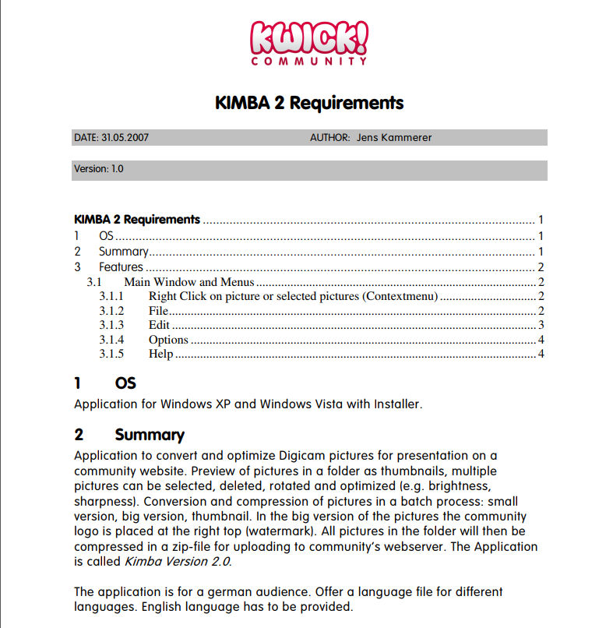
Requirements
KIMBA2 Requirements https://is.gd/Mnj24A
Communication and consultation with Business Analytics

Slide 5
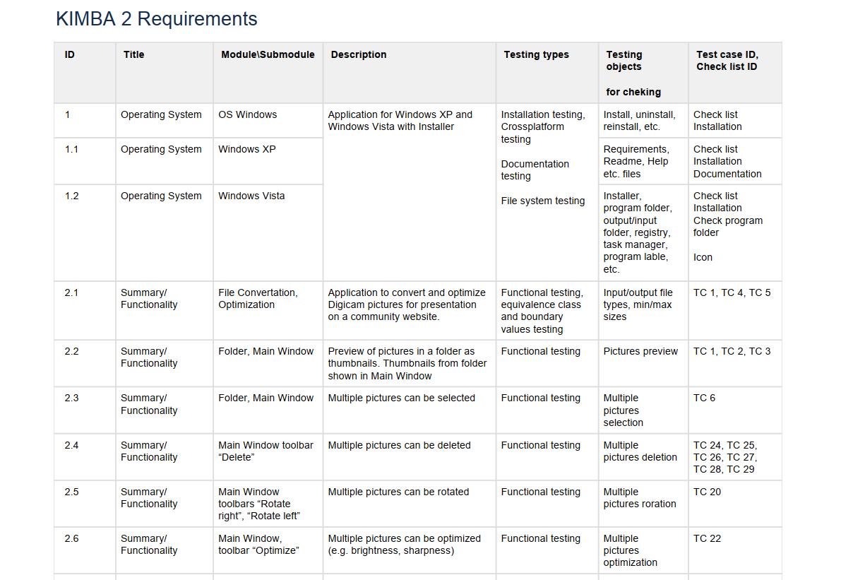
Structuring Requirements
https://is.gd/2qpYo8

Slide 6
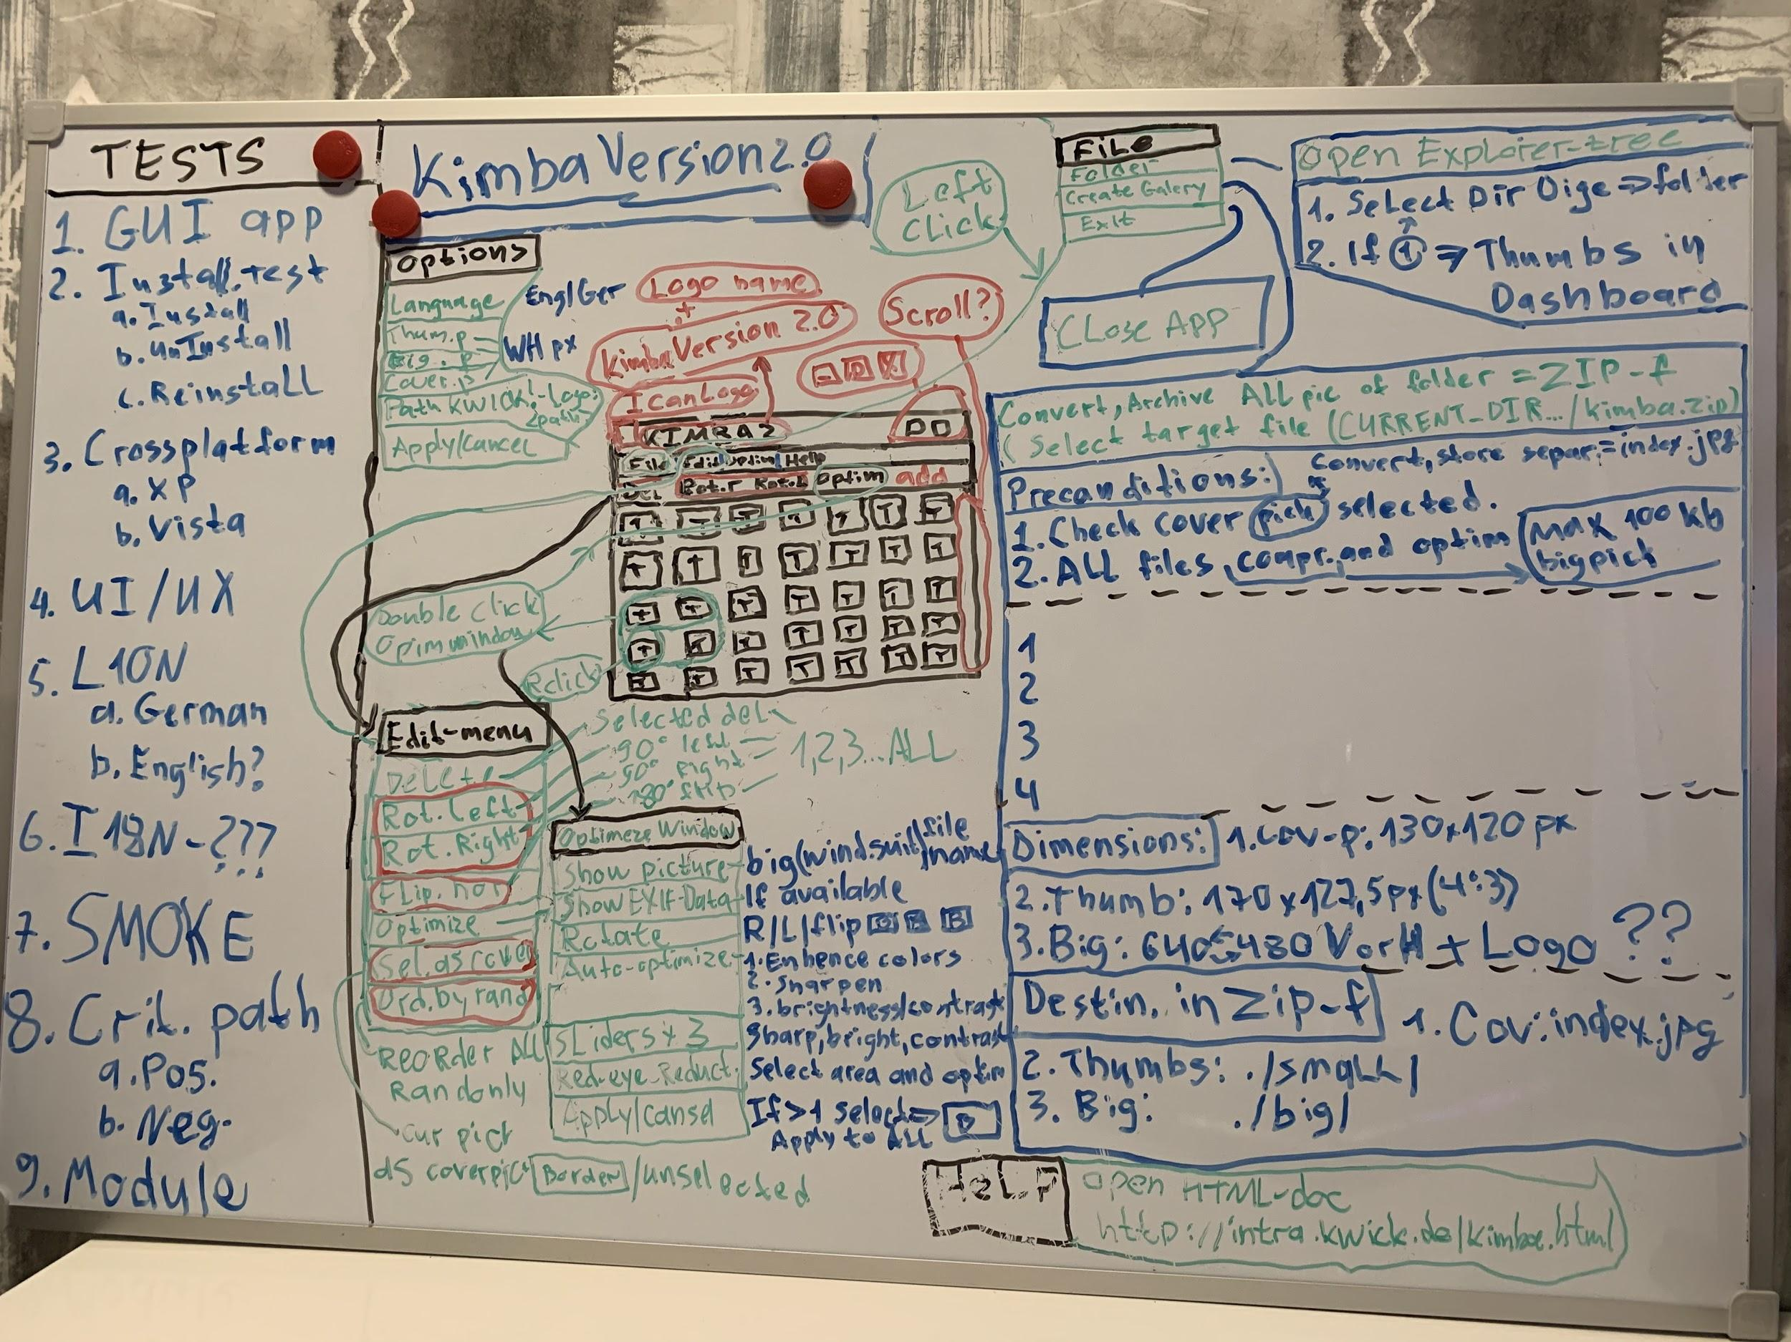
Mind Map Version 1.0

Slide 7
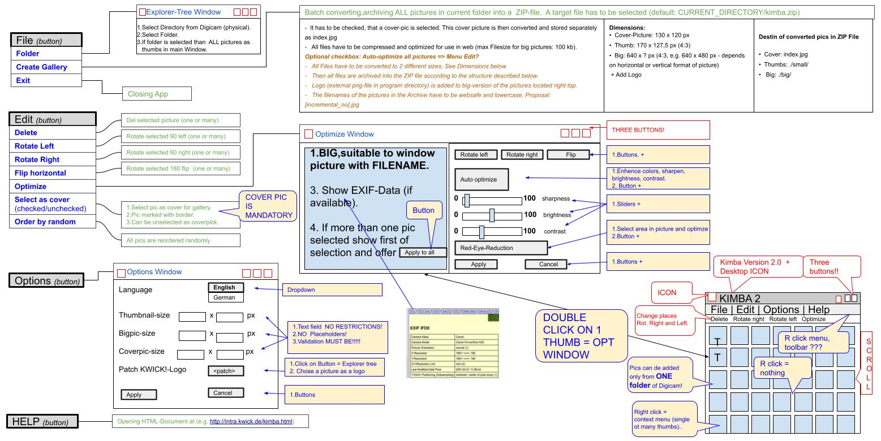
Mind Map Version 2.0

Slide 8
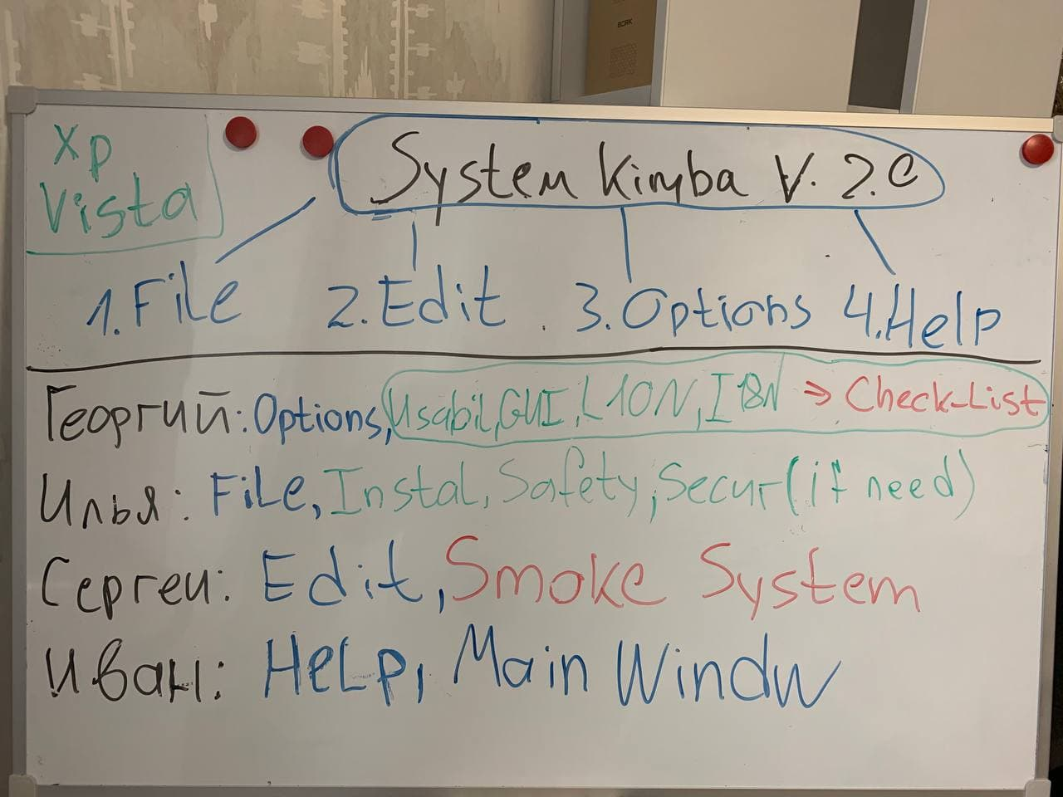
Segregation of duties

Slide 9
Segregation of duties
GEORGE BUDZKO
ILLIA VASHKEL
SERGEY ALHOVSKIY
IVAN ANISKOVETS
Module “Options”
Check-List
Usability testing
L10N testing
I18N testing
System testing
Module “File”
Integration testing: File + Options
Installation testing
Safety testing
Security testing (if need)
Module “Edit”
Smoke test System
Integration testing: Edit + Main Window
Module “Help”
Main Window

Slide 10
Testing documentation
Combined test documentation
Check - List (228 checks)
https://is.gd/wdWi2T
Set of test cases (72 TC)
https://is.gd/8WU2gk
The stability of the team.
The stability of requirements.
The large and complex logic of the project.
Test the logical functionality of the following modules:
Main window.
File.
Options.
Edit.
Help.
Their interaction.
Cross-platform testing (XP, Vista).
Testing installation.
Safety.
Security (if required).
GUI.
Usability.
Localization (English, German).
Internalization (English, German).
System testing.
Other checks.

Slide 11


Testing environment
Oracle VM VirtualBox
Version 6.1.18 r142142 (Qt5.6.2)
Window XP
Professional Version 2002 SP3 x32
Window Vista
Home Premium SP2 x32

Slide 12
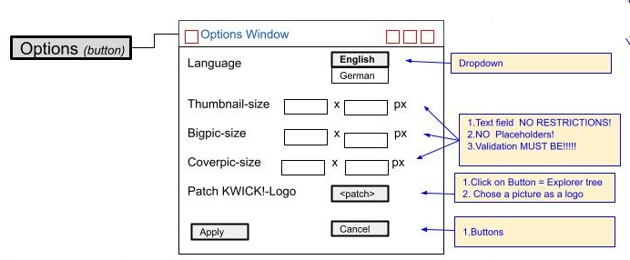
Testing and difficulties
George

Slide 13
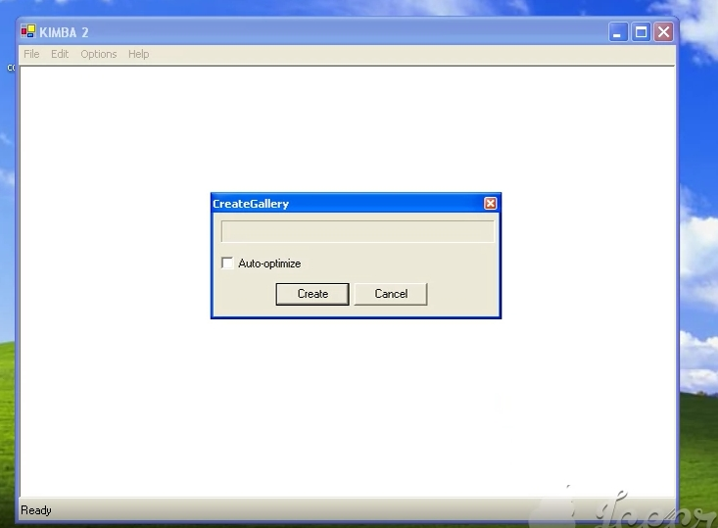
Most important defects
http://jira.it-academy.by:8080/browse/MST19020-5146
Summary:
Options,optimize,create gallery windows: >1 click at the same time outside the windows area causes the application and OS to hang
CRITICAL
Result: application and OS hang
Expected result: the application and OS must not hang, regardless of how many times it was clicked one time outside "Optimize window","Options window" or "Create Gallery".
https://is.gd/rlmOol
https://is.gd/AMTQx5
https://is.gd/pOfxaJ

Slide 14
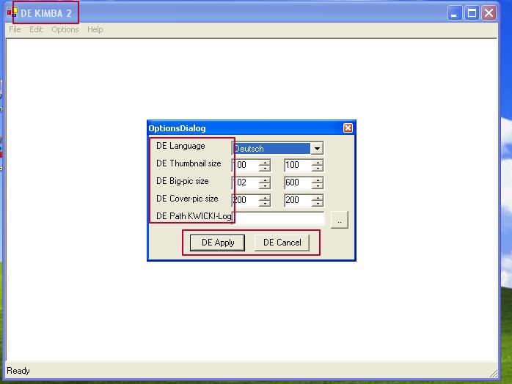
Most important defects
http://jira.it-academy.by:8080/browse/MST19020-5133
Summary:
The application doesn't support the German language version
CRITICAL
Result: the "Deutsch" version of the application adds "DE" to the title and to the words in the options menu and not support "Deusche" language
Expected result: the entire application must be translated into "Deutsche", including the main window, all modules, validation messages, installation, documents and other words, hints.

Slide 15
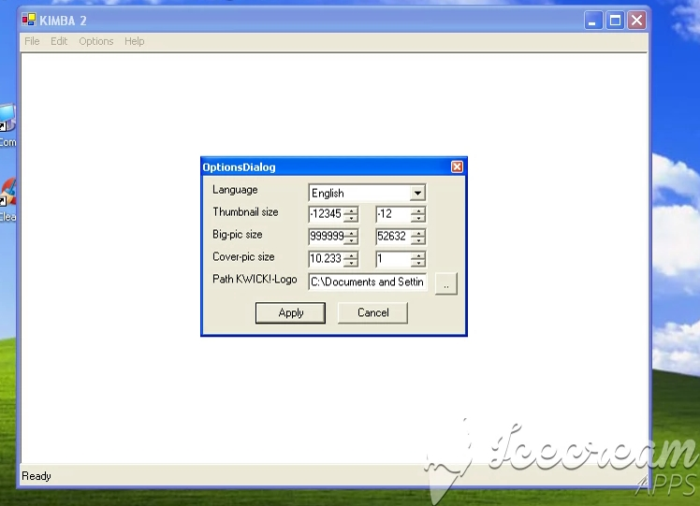
Most important defects
http://jira.it-academy.by:8080/browse/MST19020-5157
Summary:
Options window: no validation for input dimensions values from keyboard and Ctrl+V
CRITICAL
Result: no validation on input values via keyboard and Ctrl+V.
Expected result: since KIMBA 2 has restrictions on the input dimensions values in the range from 1 to 1000 integers, then there should be validation for the input values in the dimensions fields and a validation window should appear after "Apply".
https://is.gd/zjbQp1
https://is.gd/l84U16
https://is.gd/97dTRz

Slide 16
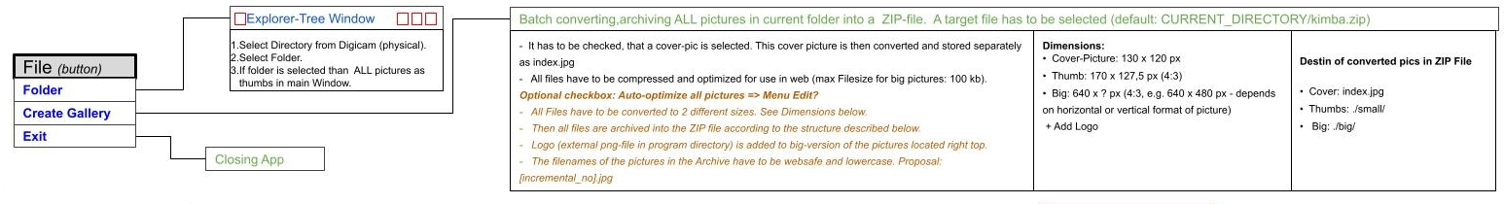
Testing and difficulties
ILLIA

Slide 17
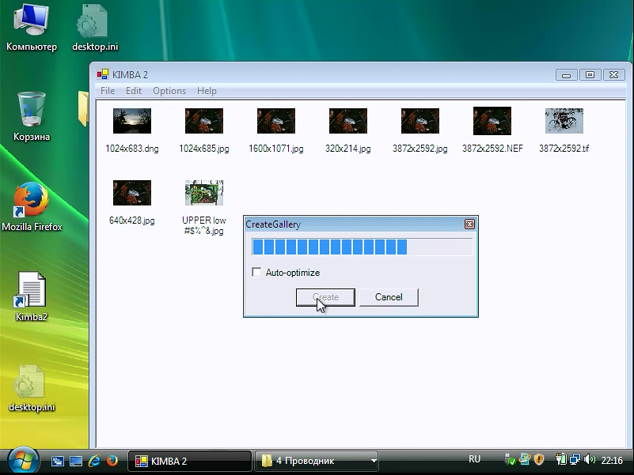
Most important defects
http://jira.it-academy.by:8080/browse/MST19020-5132
Summary:
Windows Vista: Create Gallery: pictures are not converted and archived into the ZIP file, output folder with pictures is not created
BLOCKER
Actual result: pictures are not converted and archived into the ZIP file, output folder with pictures is not created (look at the attached video).
Expected result: Files are archived into the ZIP file (default:CURRENT_DIRECTORY/kimba.zip):
Cover: index.jpg
Thumbs: ./small/
Big: ./big/.
https://is.gd/BBm8Cd

Slide 18
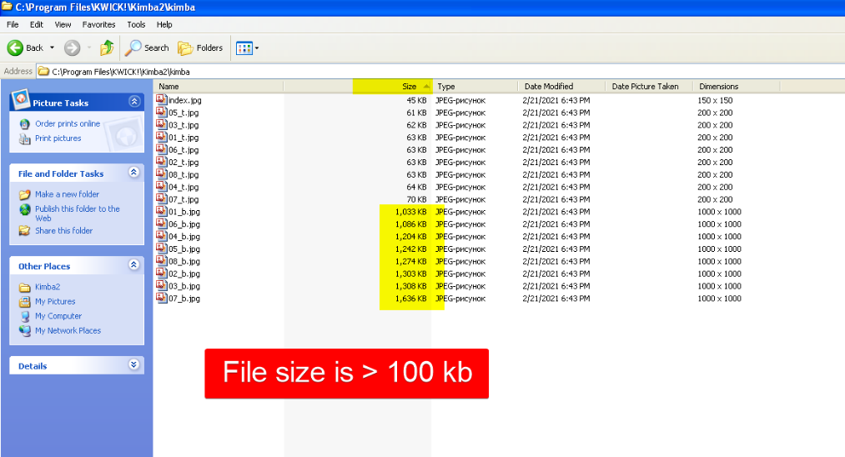
Most important defects
http://jira.it-academy.by:8080/browse/MST19020-5109
Summary:
Create Gallery: file size is more than 100 kb after compression
CRITICAL
Actual result: files are putted into the folder with the installed application Kimba (...\Kimba2\kimba\ 1_b.jpg) without archiving (look at the attached screenshot).
Expected result: Files are compressed default: CURRENT_DIRECTORY/kimba.zip) for use in web (max file size for big photos: 100 kb) and converted to the described dimensions.

Slide 19
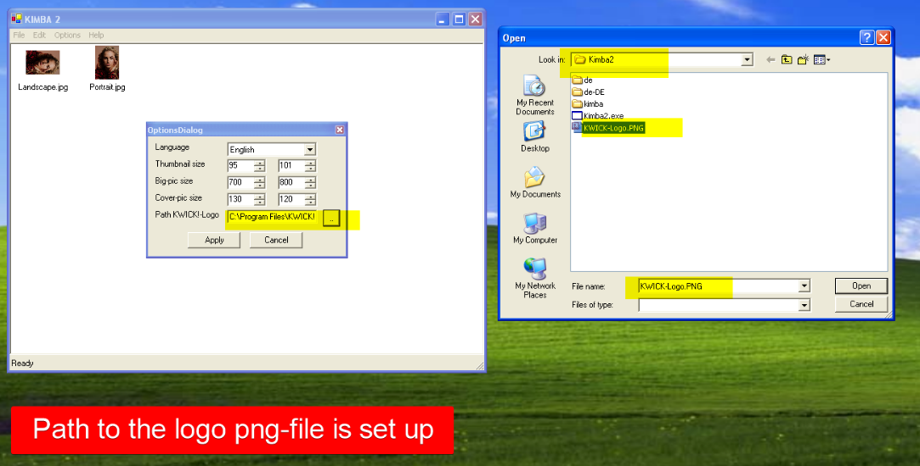
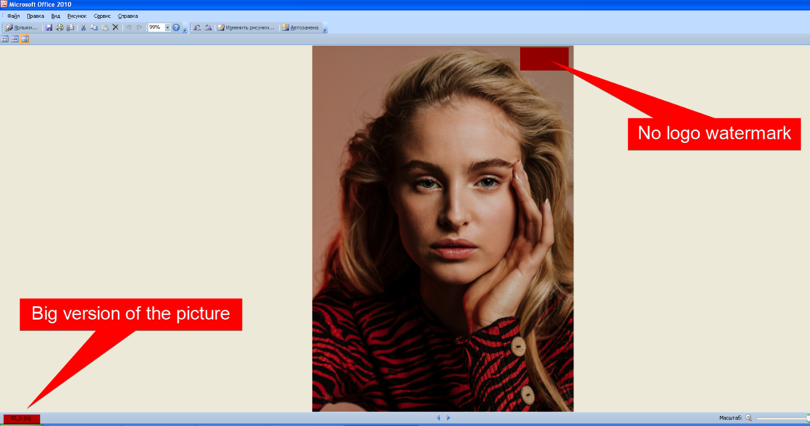
Most important defects
http://jira.it-academy.by:8080/browse/MST19020-5112
Summary:
Create Gallery: logo is not adding on the big photos
CRITICAL
Actual result: logo is not adding on the big photos (look at the attached screenshots).
Expected result: logo (external png-file in program directory) is added to big-version of the photos located right top.

Slide 20
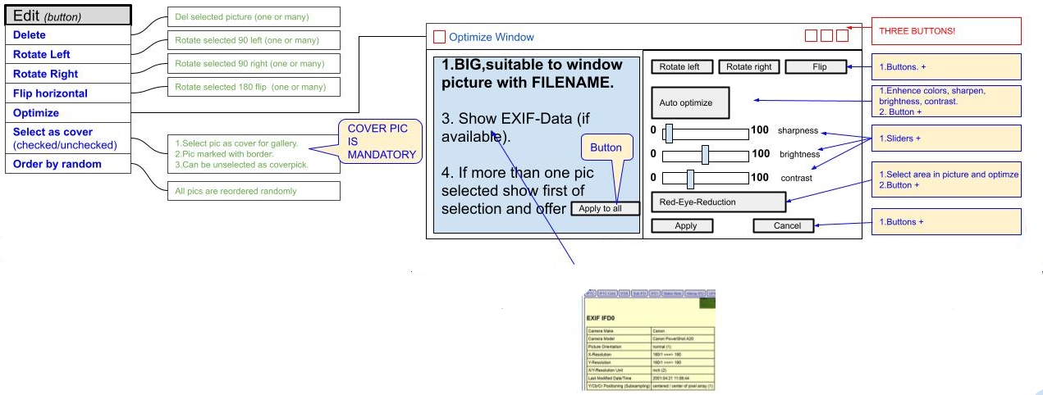
Testing and difficulties
Sergey

Slide 21
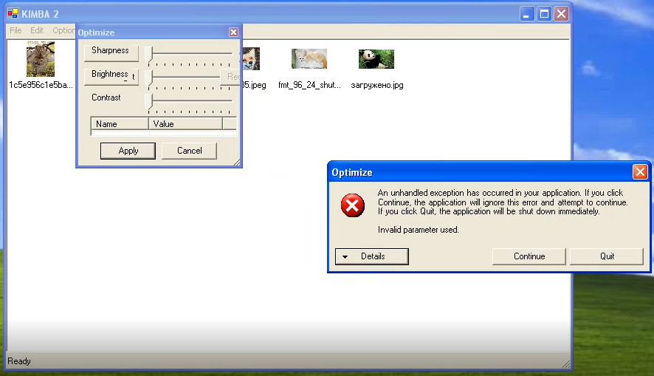
Most important defects
http://jira.it-academy.by:8080/browse/MST19020-5136
Summary:
Optimization window: shrink the window with the slider in the lower right corner crashes and blocks the application
CRITICAL
Result: an error pops up
Expected result: optimization window shrinks
https://is.gd/W5WIjV

Slide 22
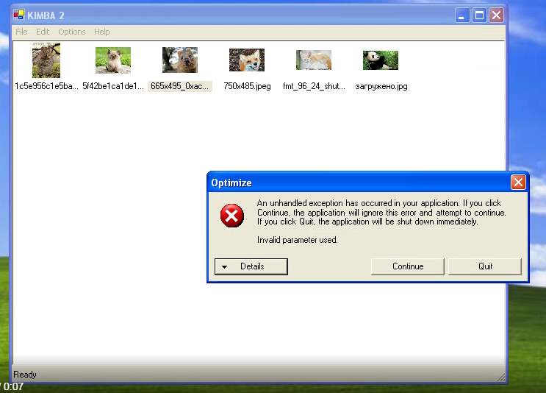
Most important defects
http://jira.it-academy.by:8080/browse/MST19020-5131
Summary:
Optimization window header line: right click and "Minimize" the window crashes and blocks the application
CRITICAL
Result: an error pops up
Expected result: the optimization window is minimized
https://is.gd/Q3Yix2

Slide 23
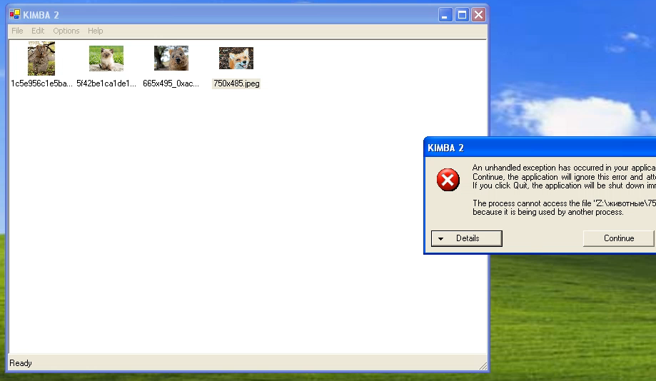
Most important defects
http://jira.it-academy.by:8080/browse/MST19020-5173
Summary:
Main menu: deletion more than one picture an error pops up
CRITICAL
Result: an error pops up
Expected result: photo is deleted
https://is.gd/mp77sV

Slide 24
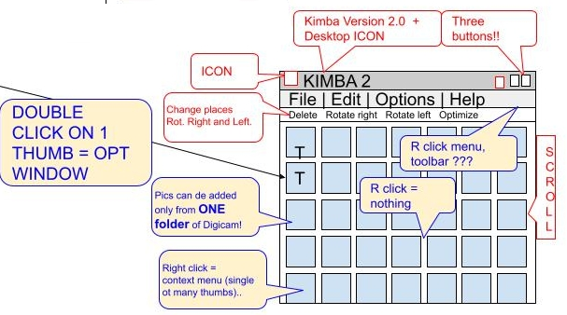
Testing and difficulties
IVAN

Slide 25
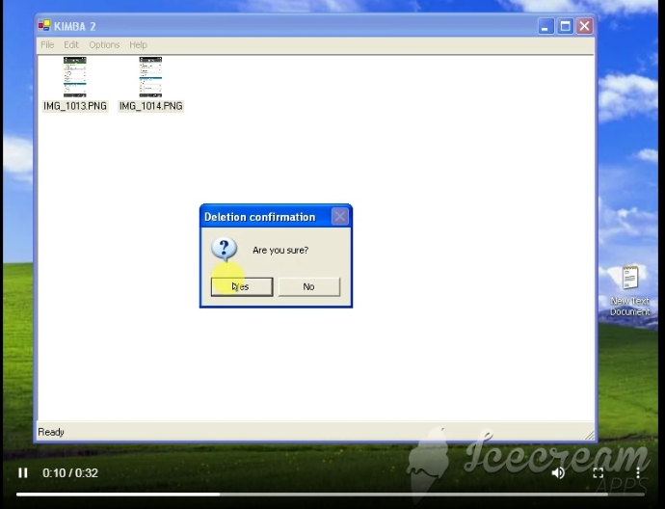
Most important defects
http://jira.it-academy.by:8080/browse/MST19020-5211
Summary:
Context menu: command "Delete" removes pictures from external folder
CRITICAL
Result: Pictures deleted from the external folder
Expected result: Pictures can not be deleted from the external folder.
https://is.gd/GZTO28

Slide 26
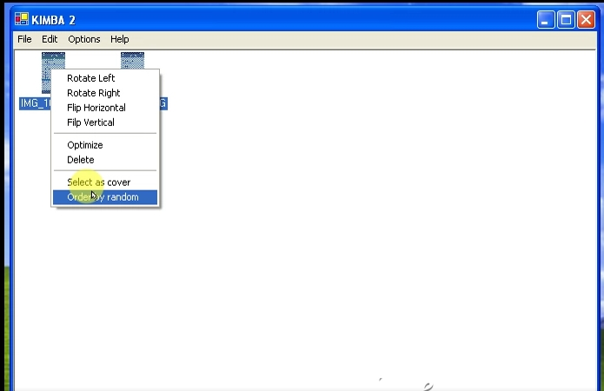
Most important defects
http://jira.it-academy.by:8080/browse/MST19020-5209
Summary:
Context menu: command "Order by random" does not work when pictures selected
MAJOR
Result:
Pictures are not randomly ordered.
Command "Order by random" does not work
Expected result:
Pictures are randomly ordered.
Command "Order by random" works.
https://is.gd/fZaVCv

Slide 27
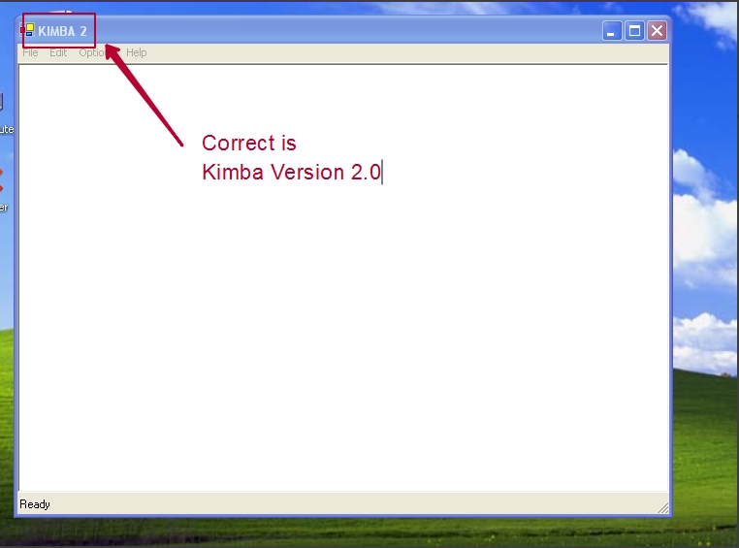
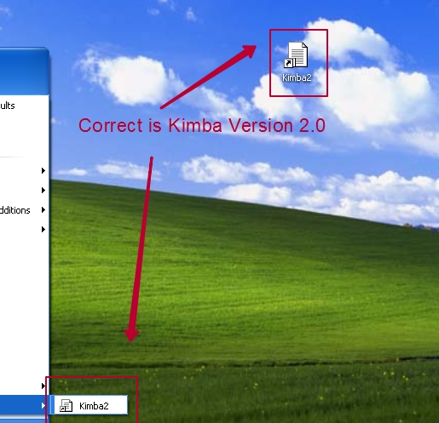
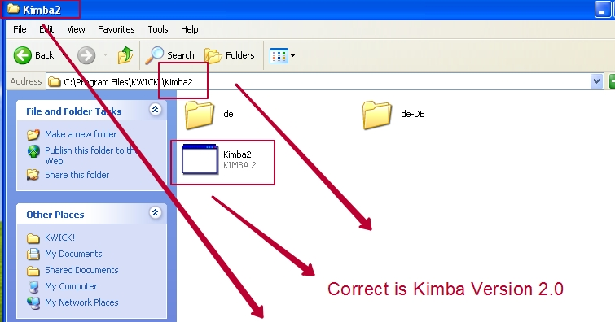
Most important defects
http://jira.it-academy.by:8080/browse/MST19020-5198
Summary:
Incorrect application name KIMBA 2
MINOR
Result: the application's name is "KIMBA 2"
Expected result: the application correct name is "Kimba Version 2.0" .

Slide 28
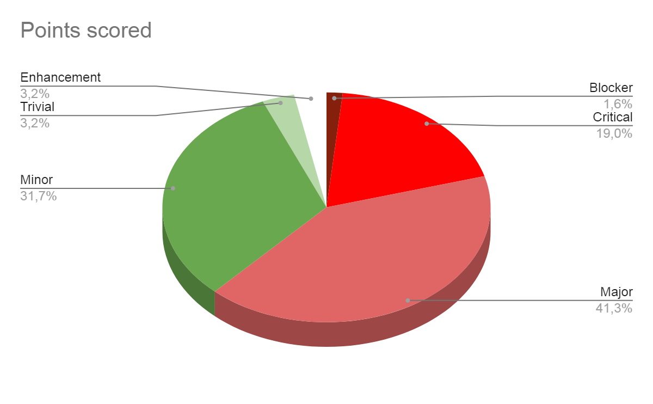
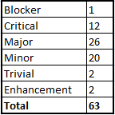
Test report and quality level
Quality
Very Low
Smoke test Unacceptable
Critical path Low
Extended Low
Testing environment:
Window XP Professional Version 2002 SP3 x32
Window Vista Home Premium SP2 x32
QA Team:
GEORGE BUDZKO : jorik_@mail.ru
ILLIA VASHKEL: iluich67@gmail.com
SERGEY ALHOVSKIY: Malyava_07@mail.ru
IVAN ANISKOVETS: vana_2368@mail.ru
Recommendations:
Fix all blocker, critical and major issues before the Demo.
Create working German language version of the app.

Slide 29
Questions?
Thanks for attention )))

